Slide 1
A Web-Based Peer Interaction Framework for Improved Assessment and Supervision of Students
Michael Mogessie, Giuseppe Riccardi and Marco Ronchetti
DISI
Università degli Studi di Trento, Italy

Slide 2
Summary
The idea, the system, the process
The experiment and its results
Comments and future work

Slide 3
What's that?
A (web-based) system to force and automate a peer-study process
Tested in traditional courses
Tested in SPOCs with a partial Flipped Classroom approach
Potentially useful for MOOCs

Slide 4
Pedagogical principles
Learn by doing
Cooperative learning

Slide 5
Research questions
Is such a system useful/effective? (does it lead to better learning ?)
Can it scale at MOOCS level?

Slide 6
Research questions
Is such a system useful/effective? (does it lead to better learning ?)
Can it scale at MOOCS level?
YES
Maybe

Slide 7
The research context: peer evaluation
PRAISE (Peer Review Assignments Increase Student Experience), 2007
  assignment – review - discussion
PeerWise, 2008
  student generated multiple choice questions
PeerScholar, 2008
  essay – review – review evaluation
Peer Instruction, 2010
  in-lecture: multiple choice questions + responders + peer discussion + "right" response from teacher

Slide 8
Process and roles
Ask 1 Question
(Evaluate 3/4 question)
Select best questions (1 out of 3-5)
INSTRUCTOR
STUDENT
Assign question
Answer 1 question
Assign answer to be evaluated
Evaluate 3/4 answers
SYSTEM
Assign points (score)
Bookkeping

Slide 9
Students' activity
For every "cycle", a student:
asks ONE question
(evaluates SOME questions, not including his/her own)
responds to ONE question (not including his/her own, nor the ones he evaluated)
evaluates ONE answer (not including his/her own, nor the ones on questions he posed or evaluated)
gets a score
Moreover, s/he
can view the set of questions/answers of the closed cycles
can view the global score

Slide 10
The sample: over 500 students

Slide 11
Better study

Slide 12
Going beyond the course material

Slide 13
Student's feeling

Slide 14
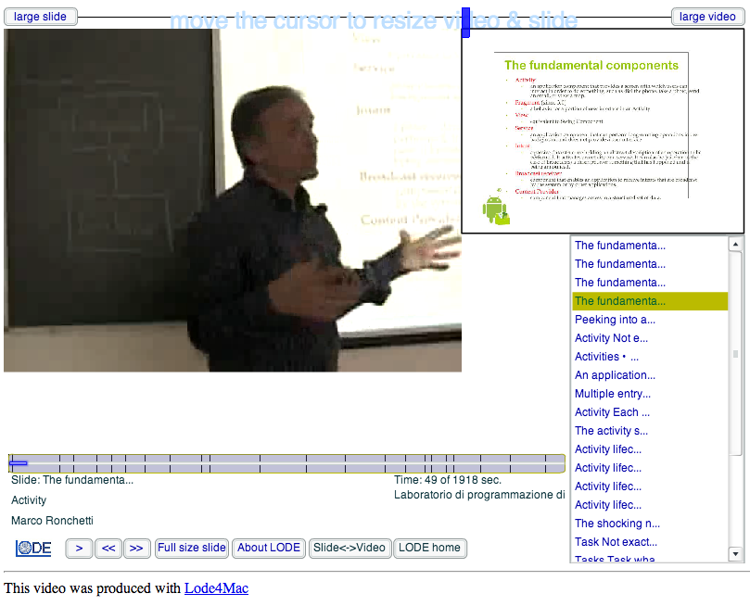
Using Videos

Slide 15
The question selection process
cluster similar or duplicate questions
decide about wrong (?) questions
select "best" ones
  most representative of the problem
  most stimulating
  formulated in the best way

Slide 16
The question selection process
cluster similar or duplicate questions
decide about wrong (?) questions
select "best" ones
  most representative of the problem
  most stimulating
  formulated in the best way
The Challenge: SCALABILITY!

Slide 17
The question selection process: helping tools (so far)
tags
students' evaluation

Slide 18
Main results
students welcomed the approach
there were measurable benefits in terms of perceived quality of the proposed framework and of better involvement of the students in the course.
Students were pushed to search learning material outside the course “walls”.
More effective for more "mature" students (?)

Slide 19
Side-effect
We gathered valuable data, which create corpora of large sets of questions, answers and evaluations.

Slide 20
Future plan
Semi-automatic selection of relevant questions
Machine-learning techniques to study historical student activity data to determine if a student’s performance level can be predicted at different stages of the course
Enhance the gamification aspects

Slide 21
Thanks for the attention.
Any question?

