Slide 1
Wikis etc.

Slide 2
Wiki
A wiki is a web application which allows people to add, modify, or delete content in collaboration with others.
In a typical wiki, text is written using a simplified markup language (known as "wiki markup") or a rich-text editor.
While a wiki is a type of content management system, it differs from a blog or most other such systems in that the content is created without any defined owner or leader, and wikis have little implicit structure, allowing structure to emerge according to the needs of the users.

Slide 3
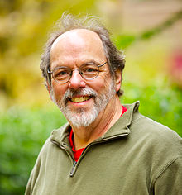
Ward Cunningham

Slide 4
Wikipedia
Wikipedia Foundation
Wikimedia
Mediawiki
How does it work?

Slide 5
A case
https://it.wikipedia.org/wiki/Cammoro
https://it.wikipedia.org/w/index.php?title=Cammoro&offset=20061107221949&action=history
https://it.wikipedia.org/w/index.php?title=Sellano&type=revision&diff=4762118&oldid=4535494

Slide 6
Vandalism and hoaxes
https://en.wikipedia.org/wiki/Wikipedia:List_of_hoaxes_on_Wikipedia
"Our vandalism rate is very low," said one senior editor, who wished to remain anonymous for privacy reasons. "It didn’t used to be, but it is very very low ... because we have people watching."

Slide 7
School initiatives in Italy
https://it.wikipedia.org/wiki/Progetto:Coordinamento/Scuole
https://it.wikipedia.org/wiki/Progetto:Coordinamento/Scuole/UNIPD_beni_culturali
https://it.wikipedia.org/wiki/Progetto:Coordinamento/Scuole/PoliMi
http://wiki.wikimedia.it/wiki/Adotta_una_parola_va_a_scuola

Slide 8
The sandbox
User:Sandbox
User:Ronchet/sandbox

Slide 9
Quick overview of wiki markup
'''three apostrophes''' will make text bold
''two apostrophes''' will make text italic
[[Text in double square brackets]] will be links to the page named as the text in the brackets
[[Link target|link text]] will display a link that looks like link text but links to link target
The wiki is case sensitve – but not on the first letter of a link
The wiki is Unicode

Slide 10
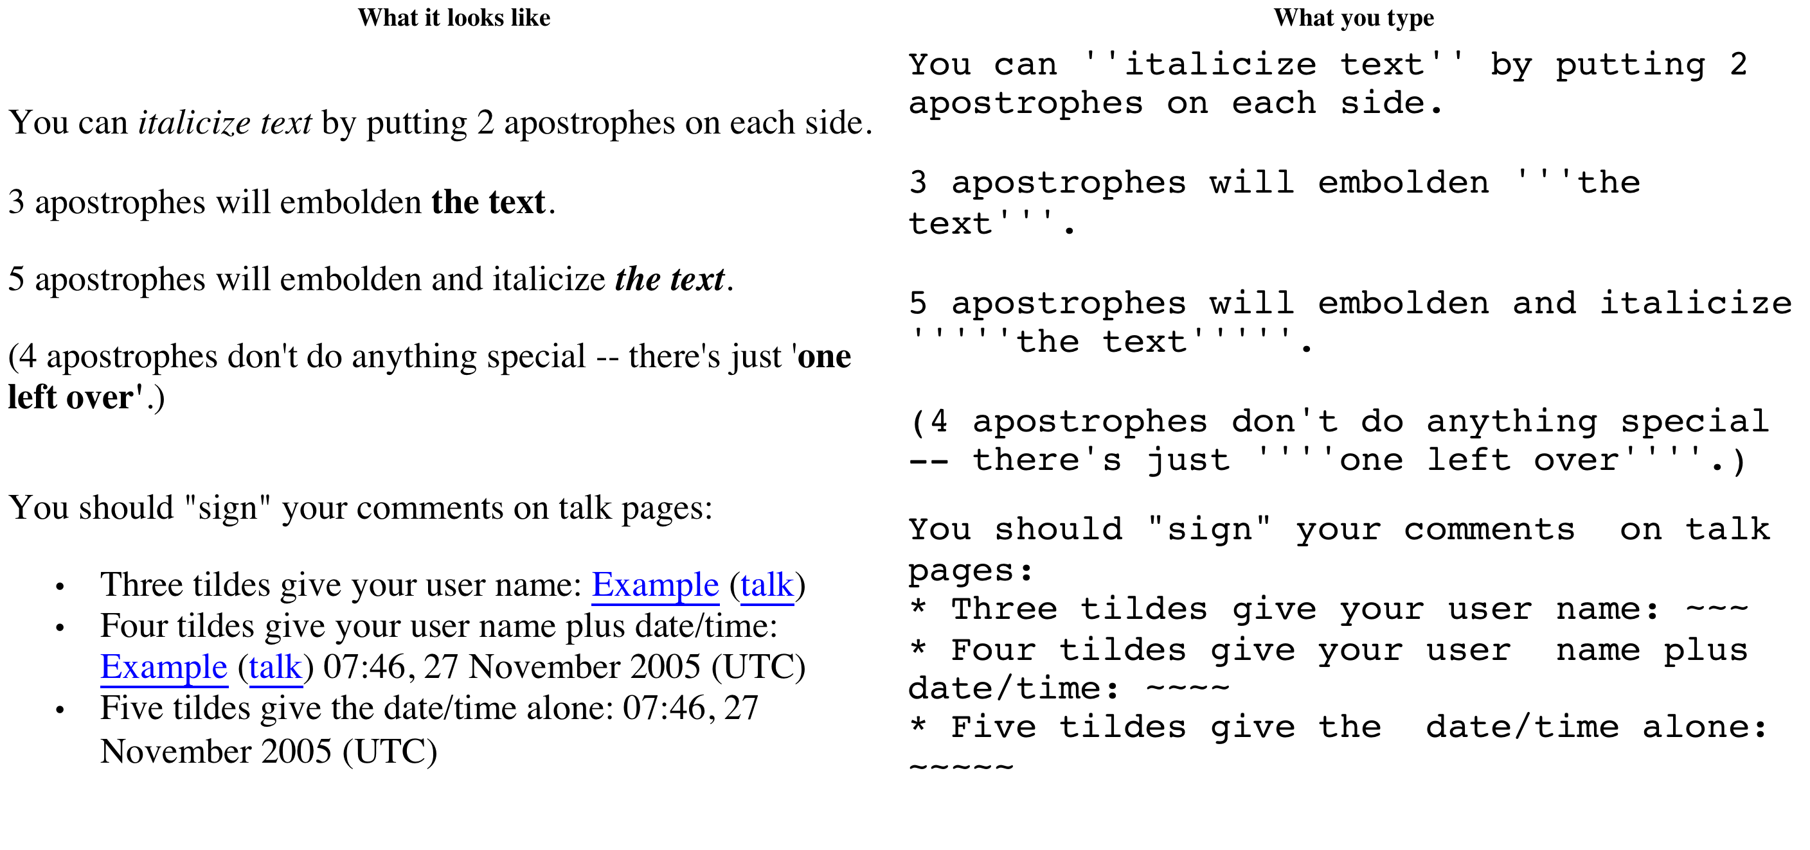
Basic mediawiki markup

Slide 11
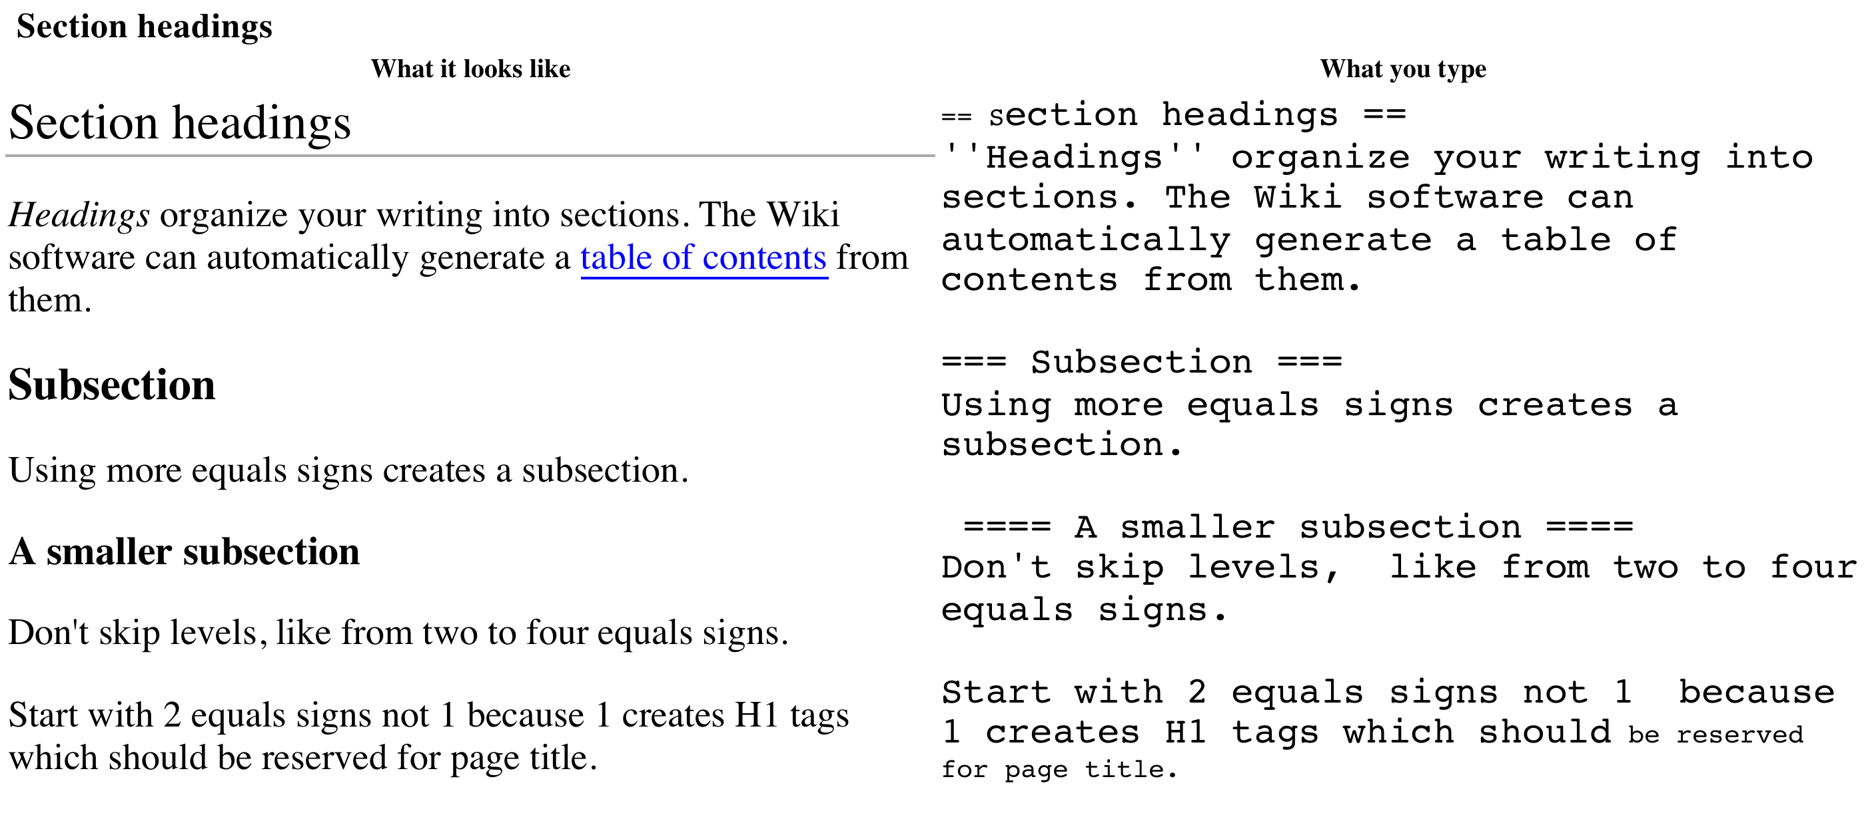
Headings

Slide 12
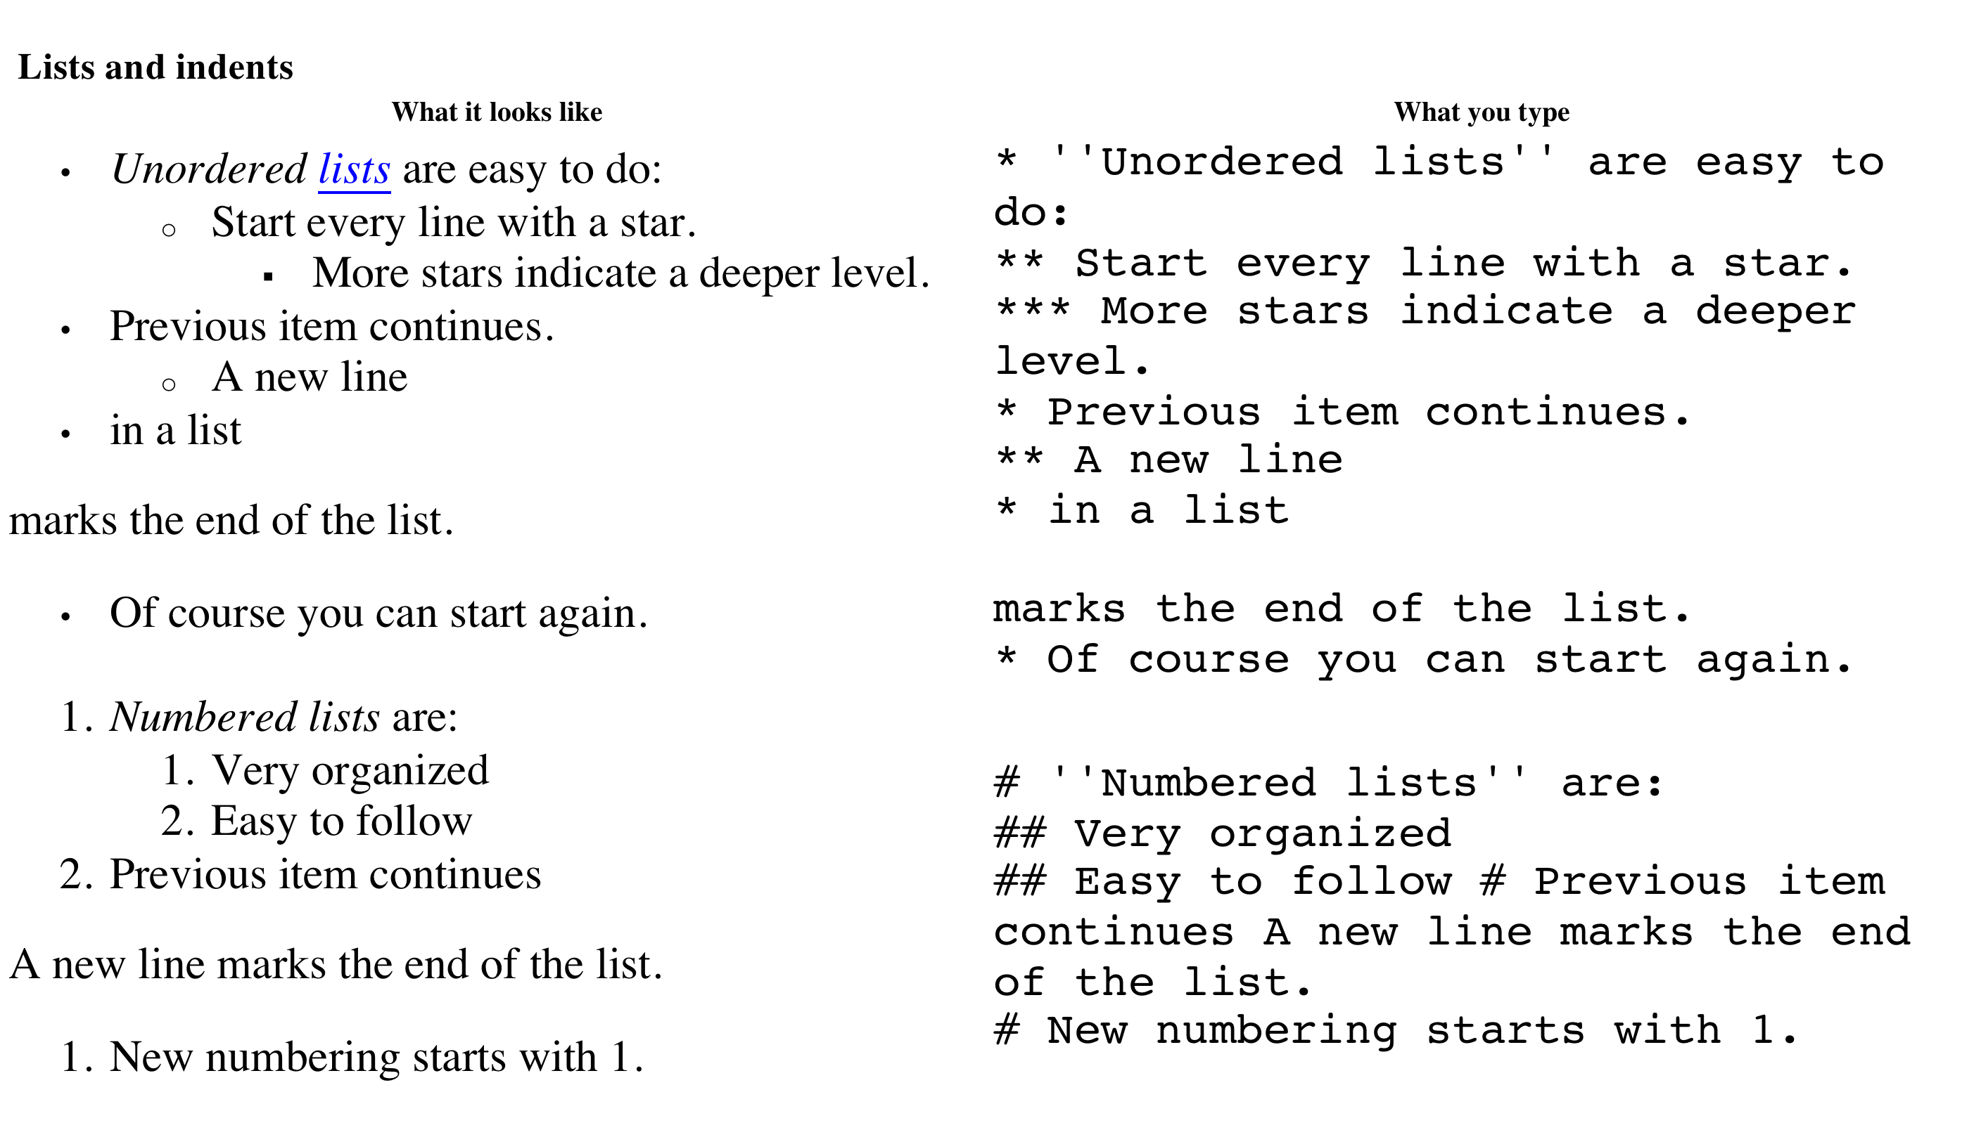
Lists

Slide 13
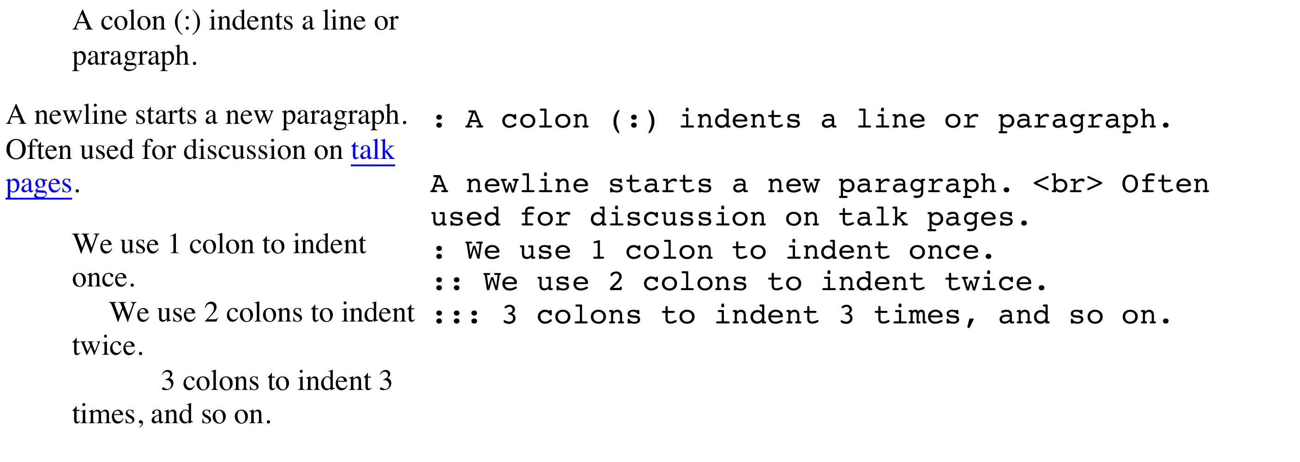
Indents

Slide 14
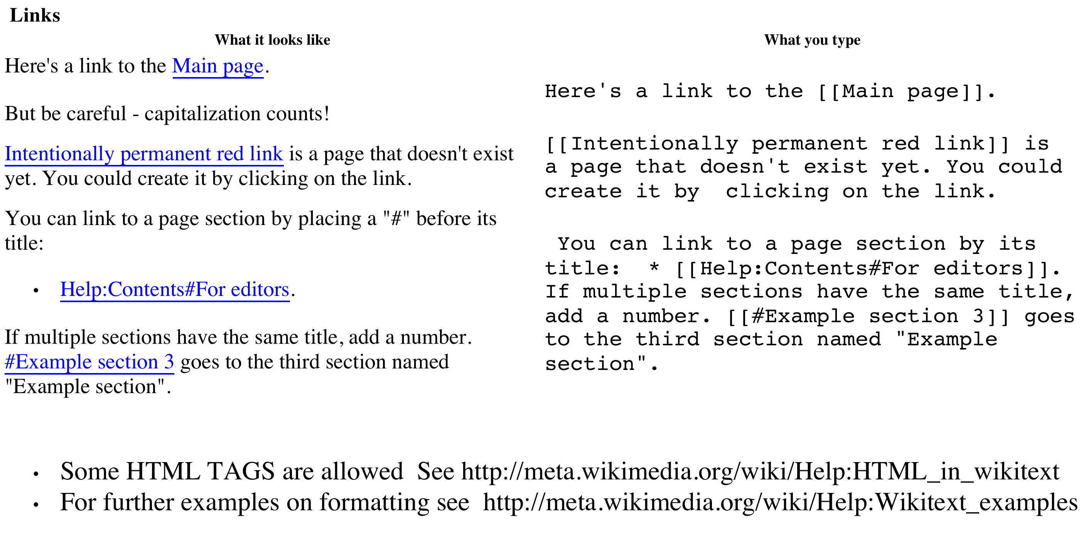
Links

Slide 15
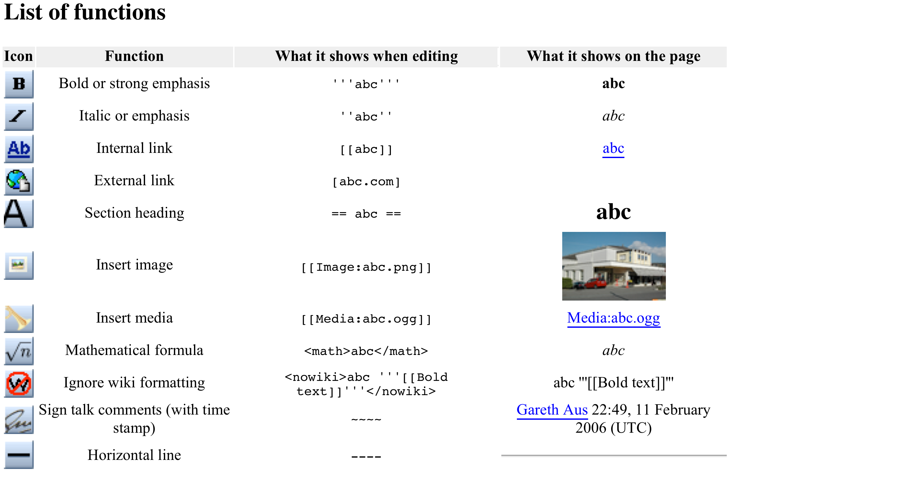
List of functions

Slide 16
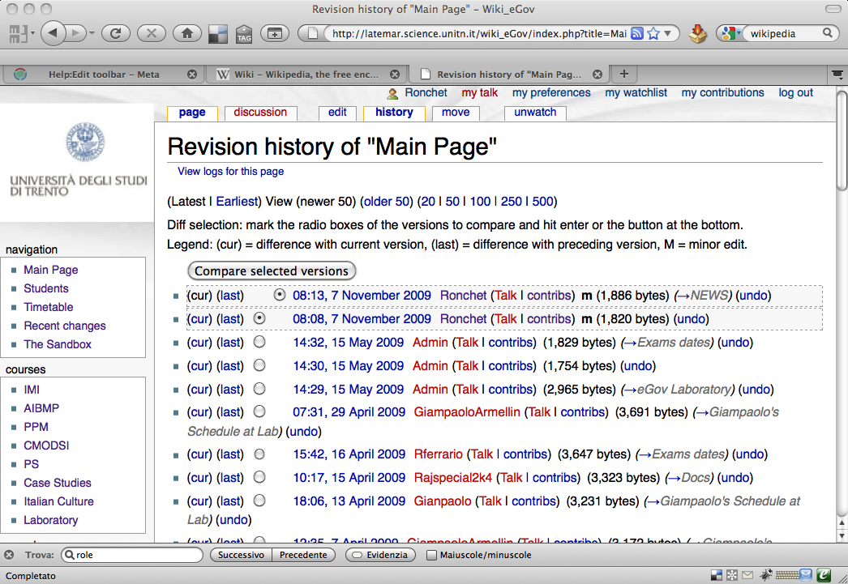

Slide 17
Validation
The role of the community

