Slide 1

Intro to SPA framework
Modified from a presentation by
Jussi Pohjolainen

Slide 2

Rise of the Responsive Single Page App
Image: http://johnpolacek.github.io/scrolldeck.js/decks/responsive/

Slide 3
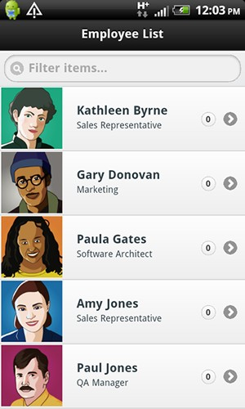
Responsive
Uniﬁed across experiences
Can be embedded as mobile app
Better deployment and & maintanence
Mobile users need to get access to everything
Image: http://coenraets.org/blog/wp-­‐content/uploads/2011/10/directory11.png

Slide 4
Single-­‐page Applications (SPA)
Web app that ﬁts on a single web page
  Fluid UX, like desktop app
  Examples like Gmail, Google maps
Html page contains mini-­‐views (HTML Fragments) that can be loaded in the background
No reloading of the page,
Requires handling of browser history, navigation and bookmarks

Slide 5
JavaScript
SPAs are implemented using JavaScript and
HTML

Slide 6
Challenges in SPA
DOM Manipulation
  How to manipulate the view eﬃciently?
History
  What happens when pressing back button?
Routing
  Readable URLs?
Data Binding
  How bind data from model to view?
View Loading
  How to load the view?
Lot of coding! You could use a framework instead ...

Slide 7
Single-page Application
Single page apps typically have
  “application like” interaction
  dynamic data loading from the server-side API
  fluid transitions between page states
  more JavaScript than actual HTML
They typically do not have
  support for crawlers (not for sites relying on search traffic)
  support for legacy browsers (IE7 or older, dumbphone browsers)

Slide 8
SPAs Are Good For …
“App-like user experience”
Binding to your own (or 3rd party) RESTful API
Replacement for Flash or Java in your web pages
Hybrid (native) HTML5 applications
Mobile version of your web site
The SPA sweet spot is likely not on web sites,
but on content-rich cross-platform mobile apps

Slide 9
PJAX
Pjax is a technique that allows you to progressively enhance normal links on a page so that clicks result in the linked content being loaded via Ajax and the URL being updated using HTML5 pushState, avoiding a full page load.
In browsers that don't support pushState or that have JavaScript disabled, link clicks will result in a normal full page load. The Pjax Utility makes it easy to add this functionality to existing pages.
http://yuilibrary.com/yui/docs/pjax/

Slide 10
SPAs and Other Web App Architectures
 | Server-side | Server-side + AJAX | PJAX | SPA
What | Server round-trip on every app state change | Render initial page on server, state changes on the client | Render initial page on server, state changes on server, inject into DOM on client-side | Serve static page skeleton from server; render every change on client-side
How | UI code on server; links & form posting | UI code on both ends; AJAX calls, ugly server API | UI code on server, client to inject HTTP, server API if you like | UI code on client, server API
Ease of development
UX & responsiveness
Robots & old browsers
Who’s using it? | Amazon, Wikipedia; banks, media sites etc. | Facebook?; widgets, search | Twitter, Basecamp, GitHub | Google+, Gmail, FT; mobile sites, startups
FROM: LAURI SVAN

Slide 11
ANGULAR_JS

Slide 12
Angular JS
Single Page App Framework for JavaScript
Implements client-­‐side MVC pattern
– Separation of presentation from business logic and presentation state
No direct DOM manipulation, less code
Support for all major browsers
Supported by Google
Large and fast growing community

Slide 13
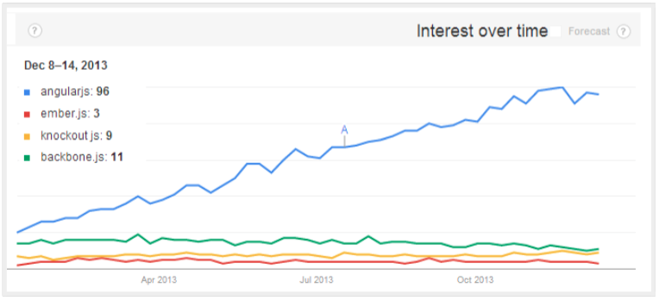
Interest in AngularJS
Google Product = Steller level & quality of support
Google Backing = Increased credibility & interest
From Gary Arora

Slide 14
AngularJS – Main Concepts
Templates
Directives
Expressions
Data binding
Scope
Controllers
Modules
Filters
Services
Routing

Slide 15
Anatomy of a Backbone SPA
Application as a ‘singleton’ reference holder
Router handles the navigation and toggles between views
Models synchronize with Server API
Bulk of the code in views
All HTML in templates
FROM: LAURI SVAN

Slide 16
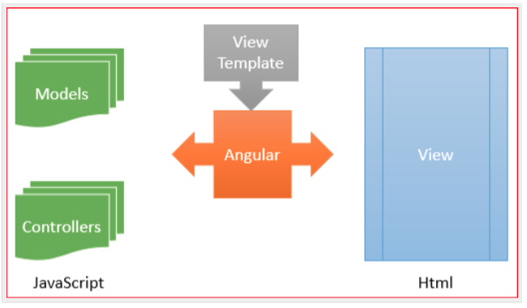
From Gary Arora

Slide 17
SPA Client-Server Communication
HTML and all the assets are loaded in first request
Additional data is fetched over XMLHTTPRequest
If you want to go real-time, WebSockets (socket.io) can help you
When it gets slow, cluster the backend behind a caching reverse proxy like Varnish
FROM: LAURI SVAN

Slide 18
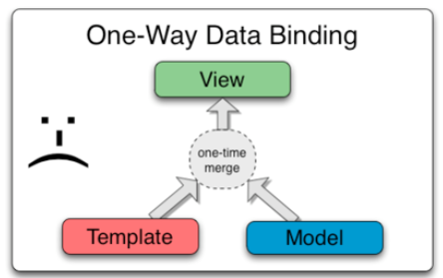
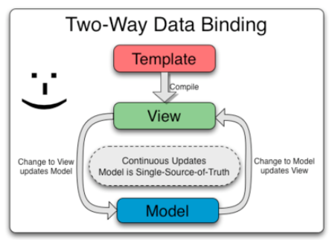
HOW IT WORKS?

Slide 19
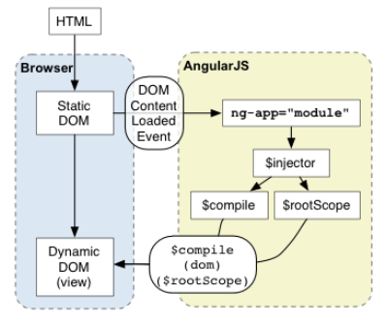
HOW IT WORKS?

Slide 20
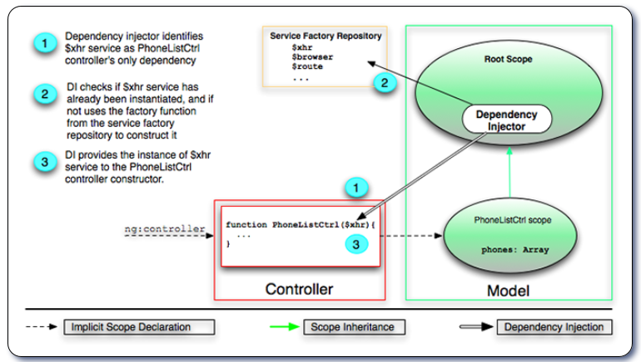
HOW IT WORKS?

Slide 21
GETTING STARTED WITH ANGULAR_JS

Slide 22
Basic Concepts
1) Templates
  HTML with additional markup, directives, expressions, ﬁlters ...
2) Directives
  Extend HTML using ng-app, ng-bind, ng-model
3) Filters
  Filter the output: filter, orderBy, uppercase
4) Data Binding
  Bind model to view using expressions {{ }}

Slide 23

First Example – Template
<!DOCTYPE html>
<html>
<head>
<title>Title</title>
<meta charset="UTF-8" />
<style media="screen"></style>
<script src="https://ajax.googleapis.com/ajax/libs/angularjs/1.4.8/angular.min.js"></script>
</head>
<body>
<div ng-app>
<!-- store the value of input field into a variable name -->
<p>Name: <input type="text" ng-model="name"></p>
<!-- display the variable name inside (innerHTML) of p -->
<p ng-bind="name"></p>
</div>
</body>
</html>
Template

Slide 24
2) Directives
Directives apply special behavior to attributes or elements in HTML
  Attach behaviour, transform the DOM
Some directives
  ng-app
    Initializes the app
  ng-model
    Stores/updates the value of the input ﬁeld into a variable
  ng-bind
    Replace the text content of the speciﬁed HTML with the value of given expression

Slide 25
About Naming
AngularJS HTML Compiler supports multiple formats
  ng-bind
    Recommended Format
  data-ng-bind
    Recommended Format to support HTML validation
  ng_bind, ng:bind, x-ng-bind
    Legacy, don't use

Slide 26
Lot of Built in Directives
ngApp
ngClick
ngController
ngModel
ngRepeat
ngSubmit
ngDblClick
ngMouseEnter
ngMouseMove
ngMouseLeave
ngKeyDown
ngForm

Slide 27
2) Expressions
Angular expressions are JavaScript-­‐like code snippets that are usually placed in bindings
  {{ expression }}.
Valid Expressions
– {{ 1 + 2 }}
– {{ a + b }}
  {{ items[index] }}
Control ﬂow (loops, if) are not supported!
You can use ﬁlters to format or ﬁlter data

Slide 28
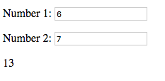



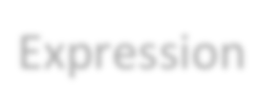
Example
<!DOCTYPE html>
<html>
<head>
<title>Title</title>
<meta charset="UTF-8" />
<style media="screen"></style>
<script src="https://ajax.googleapis.com/ajax/libs/angularjs/1.4.8/angular.min.js"></script>
</head>
<body>
<div ng-app>
<p>Number 1: <input type="number" ng-model="number1"></p>
<p>Number 2: <input type="number" ng-model="number2"></p>
<!-- expression -->
<p>{{ number1 + number2 }}</p>
</div>
</body>
</html>
Directive
Directive
Expression

Slide 29
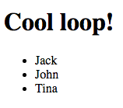
ng-­‐init and ng-­‐repeat directives
<!DOCTYPE html>
<html data-ng-app="">
<head>
<title>Title</title>
<meta charset="UTF-8" />
<script src="https://ajax.googleapis.com/ajax/libs/angularjs/1.4.8/angular.min.js"></script>
</head>
<body>
<div data-ng-init="names = ['Jack', 'John', 'Tina']">
<h1>Cool loop!</h1>
<ul>
<li data-ng-repeat="name in names">{{ name }}</li>
</ul>
</div>
</body>
</html>

Slide 30
3) Filter
With ﬁlter, you can format or ﬁlter the output
Formatting
  currency, number, date, lowercase, uppercase
Filtering
  filter, limitTo
Other
  orderBy, json

Slide 31
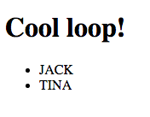



Using Filters -­‐ Example
<!DOCTYPE html>
<html data-ng-app="">
<head>
<title>Title</title>
<meta charset="UTF-8" />
<style media="screen"></style>
<script src="https://ajax.googleapis.com/ajax/libs/angularjs/1.4.8/angular.min.js"></script>
</head>
<body>
<div data-ng-init="customers = [{name:’tina'}, {name:’jack'}]">
<h1>Cool loop!</h1>
<ul>
<li data-ng-repeat="customer in customers | orderBy:'name'">
{{ customer.name | uppercase }}</li>
</ul>
</div>
</body>
</html>
Filter
Filter

Slide 32
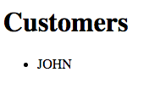
Using Filters -­‐ Example
<!DOCTYPE html>
<html data-ng-app="">
<head>
<title>Title</title>
<meta charset="UTF-8" />
<style media="screen"></style>
<script src="https://ajax.googleapis.com/ajax/libs/angularjs/1.4.8/angular.min.js"></script>
</head>
<body>
<div data-ng-init=
"customers = [{name:'jack'}, {name:'tina'}, {name:'john'}, {name:'donald'}]">
<h1>Customers</h1>
<ul>
<li data-ng-repeat="customer in customers | orderBy:'name' | filter:'john'">{{ customer.name | uppercase }}</li>
</ul>
</div>
</body>
</html>

Slide 33
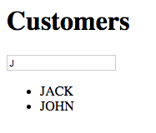
Using Filters – User Input Filters the Data
<!DOCTYPE html>
<html data-ng-app="">
<head>
<title>Title</title>
<meta charset="UTF-8" />
<style media="screen"></style>
<script src="https://ajax.googleapis.com/ajax/libs/angularjs/1.4.8/angular.min.js"></script>
</head>
<body>
<div data-ng-init=
"customers = [{name:'jack'}, {name:'tina'}, {name:'john'}, {name:'donald'}]">
<h1>Customers</h1>
<input type="text" data-ng-model="userInput" />
<ul>
<li data-ng-repeat="customer in customers | orderBy:'name' | filter:userInput">{{ customer.name | uppercase }}</li>
</ul>
</div>
</body>
</html>

Slide 34
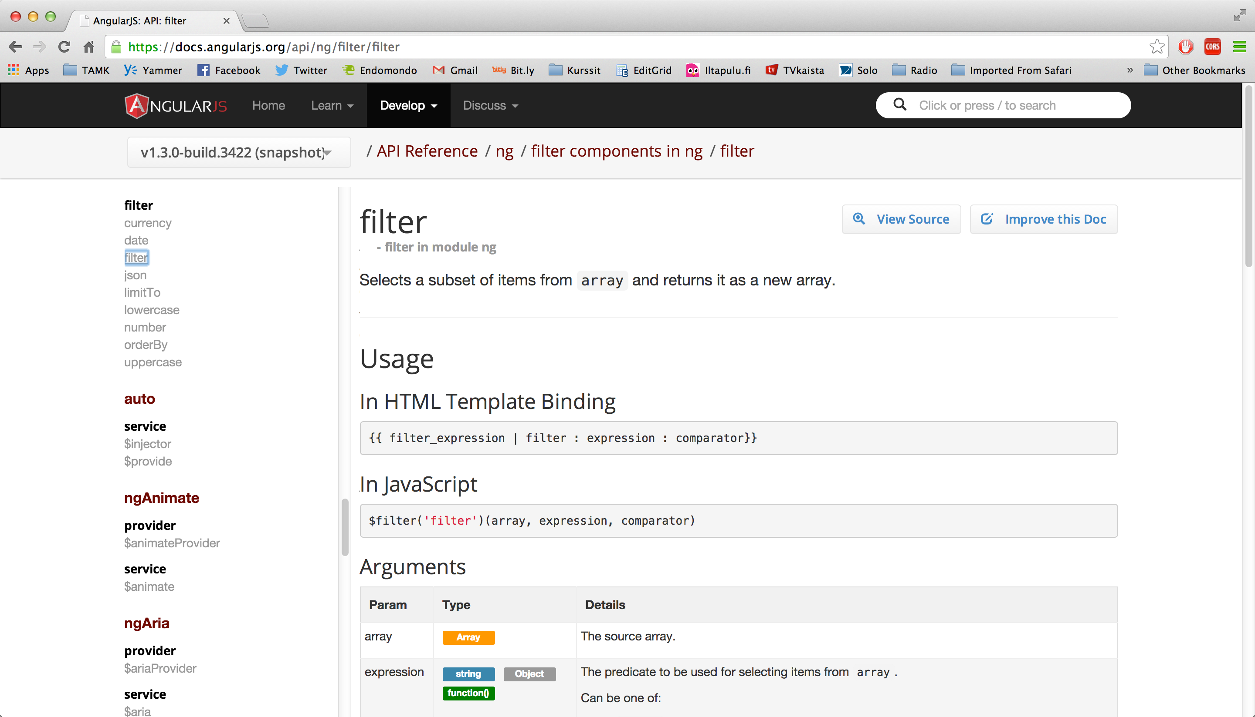
API Reference
https://docs.angularjs.org/api/ng/filter/filter

Slide 35
VIEWS, CONTROLLERS, SCOPE

Slide 36
Model – View -­‐ Controllers
Controllers provide the logic behind your app.
– So use controller when you need logic behind your UI
AngularJS apps are controller by controllers
Use ng-­‐controller to deﬁne the controller
Controller is a JavaScript Object, created by
standard JS object constructor

Slide 37
Model – View -­‐ Controllers
a controller is a JavaScript function
○ It contains data
○ It specifies the behavior
○ It should contain only the business logic needed for a single view.

Slide 38





View, Controller and Scope
View
(html fragment)
Controller
$scope
$scope is an object that can be used to communicate between
View and Controller

Slide 39
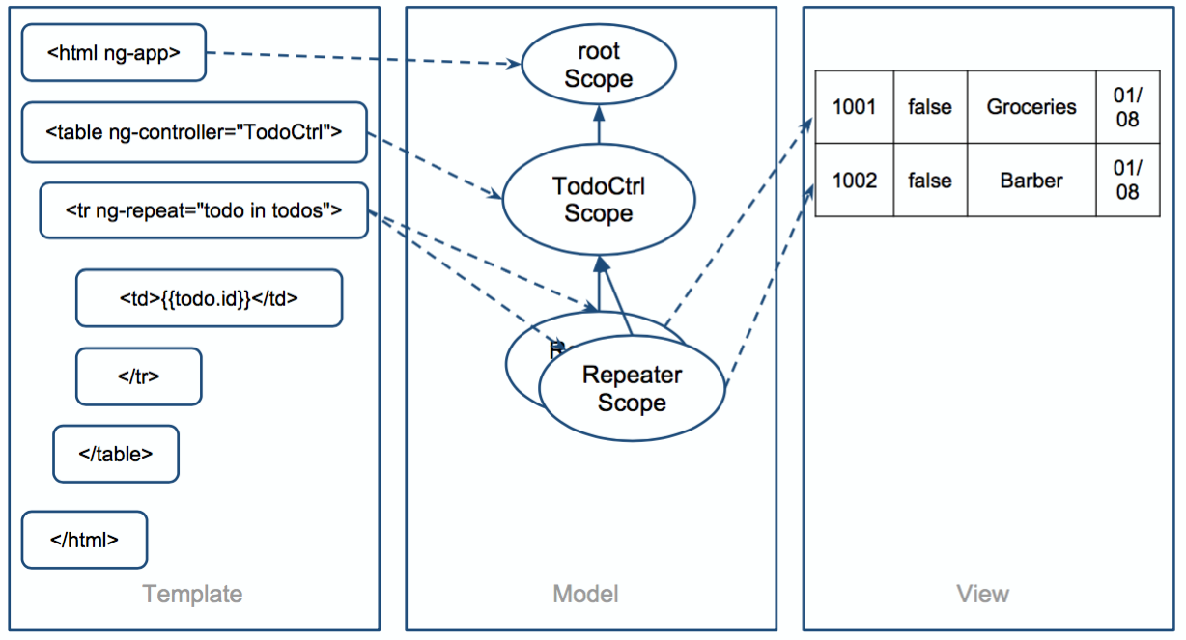
Scope

Slide 40
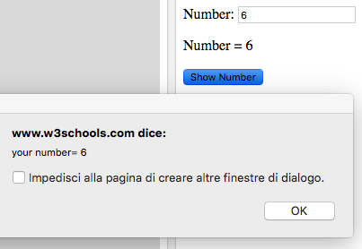
<!DOCTYPE html>
<html>
<head>
<title>Title</title>
<meta charset="UTF-8" />
<style media="screen"></style>
<script src="https://ajax.googleapis.com/
ajax/libs/angularjs/1.4.8/angular.min.js">
</script>
</head>
<body>
<div data-ng-app="myApp" data-ng-controller="NumberCtrl">
<p>Number: <input type="number" ng-model="number"></p>
<p>Number = {{ number }}</p>
<button ng-click="showNumber()">Show Number</button>
</div>
<script>
var app = angular.module('myApp', []);
app.controller('NumberCtrl', function($scope) {
$scope.number = 1;
$scope.showNumber = function(){
window.alert( "your number= " + $scope.number );
};
});
</script>
</body>
</html>

Slide 41
Modules
Module is an reusable container for diﬀerent features of your app
– Controllers, services, ﬁlters, directives...
If you have a lot of controllers, you are
polluting JS namespace
Modules can be loaded in any order
We can build our own ﬁlters and directives!

Slide 42
When to use Controllers
Use controllers
  set up the initial state of $scope object
  add behavior to the $scope object
Do not
  Manipulate DOM (use databinding, directives)
  Format input (use form controls)
  Filter output (use ﬁlters)
  Share code or state (use services)

Slide 43
App Explained
App runs inside ng-app (div)
AngularJS will invoke the constructor with a
$scope – object
$scope is an object that links controller to the view

Slide 44
MODULES, ROUTES, SERVICES

Slide 45
Example: Own Filter
// declare
a module
var myAppModule = angular.module('myApp',
[]);
// configure the module.
// in this example we will create a greeting myAppModule.filter('greet', function() {
return function(name) {
filter
return 'Hello,
};
});
' + name + '!';

Slide 46
HTML using the Filter
<div
ng-app="myApp">
<div>
{{ 'World'
| greet }}
</div>
</div>

Slide 47
Template for Controllers
// Create new module 'myApp' using angular.module method.
// The module is not dependent on any other module
var myModule = angular.module('myModule',
[]);
myModule.controller('MyCtrl', function ($scope) {
// Your controller code here!
});

Slide 48
Creating a Controller in Module
var myModule = angular.module('myModule',
[]);
myModule.controller('MyCtrl', function ($scope) {
var model = { "firstname": "Jack",
"lastname": "Smith" };
$scope.model = model;
$scope.click = function() {
alert($scope.model.firstname);
};
});

Slide 49



<!DOCTYPE html>
<html>
<head>
<title>Title</title>
<meta charset="UTF-8" />
<style media="screen"></style>
<script
<script
src="../angular.min.js"></script> src="mymodule.js"></script>
This is now the model object from MyCtrl. Model object is shared with view and controller
</head>
<body>
<div ng-app="myModule"
<div ng-controller="MyCtrl">
<p>Firstname: <input type="text" ng-model="model.firstname"></p>
<p>Lastname: <input type="text" ng-model="model.lastname"></p>
<p>{{model.firstname + " " + model.lastname}}</p>
<button ng-click="click()">Show Number</button>
</div>
</div>
</body>
</html>

Slide 50
ROUTING

Slide 51
Routing
Since we are building a SPA app, everything happens in one page
  How should back-­‐button work?
  How should linking between "pages" work?
  How about URLs?
Routing comes to rescue!

Slide 52


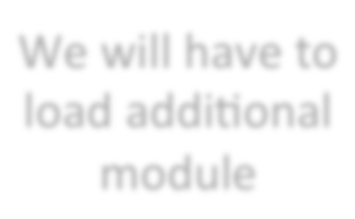



<html data-ng-app="myApp">
<head>
<title>Demonstration of Routing - index</title>
<meta charset="UTF-8" />
<script
<script
<script
</script>
</head>
src="../angular.min.js" type="text/javascript"></script> src="angular-route.min.js" type="text/javascript"></script> src="myapp.js" type="text/javascript">
We will have to load additional module
<body>
<div data-ng-view=""></div>
</body>
</html>
The content of this will change dynamically

Slide 53
// This module is dependent on ngRoute. Load ngRoute
// before this.
var myApp = angular.module('myApp', ['ngRoute']);
// Configure routing. myApp.config(function($routeProvider) {
// Usually we have different controllers for different
// In this demonstration, the controller does nothing.
$routeProvider.when('/', {
templateUrl: 'view1.html', controller: 'MySimpleCtrl' });
views.
$routeProvider.when('/view2', {
templateUrl: 'view2.html', controller: 'MySimpleCtrl' });
$routeProvider.otherwise({ redirectTo: '/' });
});
// Let's add a new controller to MyApp myApp.controller('MySimpleCtrl', function ($scope) {
});

Slide 54
Views
view1.html:
<h1>View 1</h2>
<p><a
href="#/view2">To
View
2</a></p>
view2.html:
<h1>View 2</h2>
<p><a
href="#/view1">To
View
1</a></p>

Slide 55
Working in Local Environment
If you get "cross origin requests are only supported for HTTP" ..
Either
  1) Disable web security in your browser
  2) Use some web server and access ﬁles http://..
To disable web security in chrome
  taskkill /F /IM chrome.exe
  "C:\Program Files (x86)\Google\Chrome\Application
\chrome.exe" --disable-web-security --allow-file-access- from-files

Slide 56
EXERCISE 4: ROUTING

Slide 57
Services
View-­‐independent business logic should not be in a controller
  Logic should be in a service component
Controllers are view speciﬁc, services are app-­‐spesiﬁc
  We can move from view to view and service is still alive
Controller's responsibility is to bind model to view. Model can be fetched from service!
  Controller is not responsible for manipulating (create, destroy, update) the data. Use Services instead!
AngularJS has many built-­‐in services, see
  http://docs.angularjs.org/api/ng/service
  Example: $http

Slide 58













Services
ViewCustomers
(html fragment)
ModifyCustomers
(html fragment)
$scope
$scope
ViewCustomersCtrl
ModifyCustomerCtrl
Service

Slide 59
AngularJS Custom Services using Factory
// Let's add a new controller to MyApp. This controller uses Service! myApp.controller('ViewCtrl', function ($scope, CustomerService) {
$scope.contacts = CustomerService.contacts;
});
// Let's add a new controller to MyApp. This controller uses Service! myApp.controller('ModifyCtrl', function ($scope, CustomerService) {
$scope.contacts = CustomerService.contacts;
});
// Creating a factory object that contains services for the
// controllers. myApp.factory('CustomerService', function() {
var factory = {};
factory.contacts = [{name: "Jack", salary: 3000}, {name: "Tina", salary: 5000}, {name: "John", salary: 4000}];
return factory;
});

Slide 60
Also Service
// Service
// Service
//
is instantiated
with new – keyword.
function
can use "this" and the return
value is this.
myApp.service('CustomerService', function() { this.contacts =
 | [{name: | "Jack", | salary: | 3000},
 | {name: {name: | "Tina", "John", | salary: salary: | 5000}, 4000}];
});

Slide 61
AJAX + REST

Slide 62
AJAX
Asynchronous JavaScript + XML
  XML not needed, very oden JSON
Send data and retrieve asynchronously from server in background
Group of technologies
  HTML, CSS, DOM, XML/JSON, XMLHttpRequest object and JavaScript

Slide 63
$http – example (AJAX) and AngularJS
<script type="text/javascript">
var myapp = angular.module("myapp", []);
myapp.controller("MyController", function($scope, $http) {
$scope.myData = {};
$scope.myData.doClick = function(item, event) {
var responsePromise = $http.get("text.txt");
responsePromise.success(function(data, status, headers, config) {
$scope.myData.fromServer = data;
});
responsePromise.error(function(data, status, headers, config) { alert("AJAX failed!");
});
}
} );
</script>

Slide 64
RESTful
Web Service APIs that adhere to REST architectural constrains are called RESTful
Constrains
  Base URI, such as http://www.example/resources
  Internet media type for data, such as JSON or XML
  Standard HTTP methods: GET, POST, PUT, DELETE
  Links to reference reference state and related resources

Slide 65
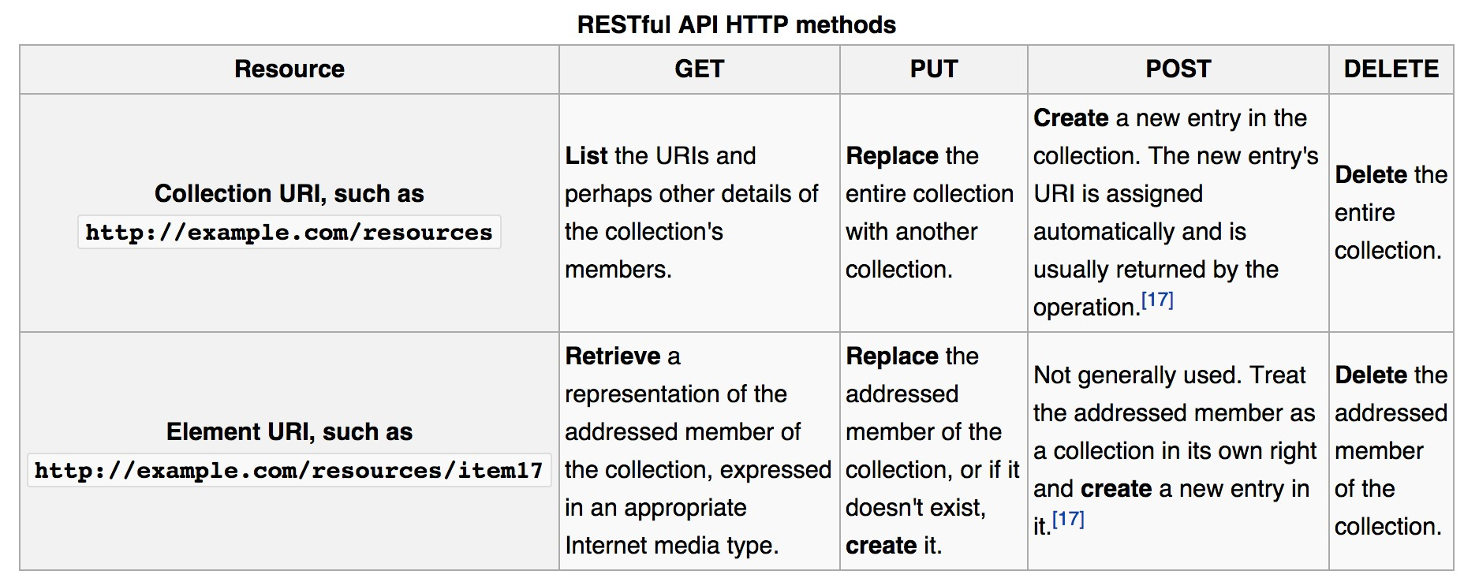
RESTful API HTTP methods (wikipedia)

Slide 66
AJAX + RESTful
The web app can fetch using RESTful data from server
Using AJAX this is done asynchronously in the background
AJAX makes HTTP GET request using url ..
– http://example.com/resources/item17
.. and receives data of item17 in JSON ...
.. which can be displayed in view (web page)

Slide 67
Example: Weather API
Weather information available from
wunderground.com
  You have to make account and receive a key
To get Helsinki weather in JSON
  http://api.wunderground.com/api/your-key/ conditions/q/Helsinki.json

Slide 68
{
"response": { "version": "0.1",
"termsofService": "http:\/\/www.wunderground.com\/weather\/api\/d\/terms.html",
"features": { "conditions": 1
}
},
"current_observation": { "image": {
"url": "http:\/\/icons.wxug.com\/graphics\/wu2\/logo_130x80.png", "title": "Weather Underground",
"link": "http:\/\/www.wunderground.com"
},
"display_location": {
"full": "Helsinki, Finland", "city": "Helsinki",
"state": "", "state_name": "Finland", "country": "FI", "country_iso3166": "FI", "zip": "00000",
"magic": "1",
"wmo": "02974",
"latitude": "60.31999969",
"longitude": "24.96999931",
"elevation": "56.00000000"
},

Slide 69


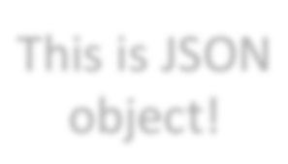
<!DOCTYPE html>
<html>
<head>
<script src="../angular.min.js" type="text/javascript"></script>
<title></title>
</head>
<body data-ng-app="myapp">
<div data-ng-controller="MyController">
<button data-ng-click="myData.doClick(item, $event)">Get Helsinki Weather</button><br /> Data from server: {{myData.fromServer}}
</div>
<script type="text/javascript">
var myapp = angular.module("myapp", []);
This is JSON object!
myapp.controller("MyController", function($scope, $http) {
$scope.myData = {};
$scope.myData.doClick = function(item, event) {
var responsePromise = $http.get("http://api.wunderground.com/api/key/conditions/ q/Helsinki.json");
responsePromise.success(function(data, status, headers, config) {
$scope.myData.fromServer = "" + data.current_observation.weather +
" " + data.current_observation.temp_c + " c";
});
responsePromise.error(function(data, status, headers, config) {
alert("AJAX failed!");
});
}
} );
</script>
</body>
</html>

Slide 70
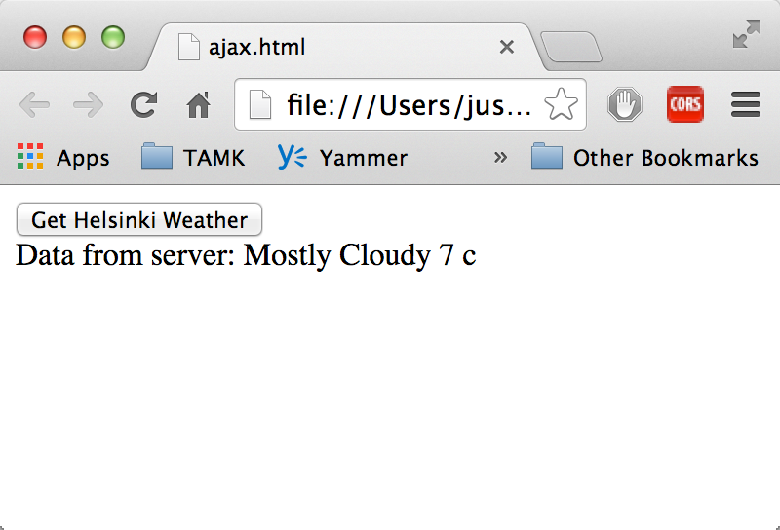
View after pressing the Button

Slide 71
$resource
Built on top of $http service, $resource is a factory that lets you interact with RESTful backends easily
$resource does not come bundled with main Angular script, separately download
– angular-resource.min.js
Your main app should declare dependency on the ngResource module in order to use
$resource

Slide 72
Getting Started with $resource
$resource expects classic RESTful backend
– http://en.wikipedia.org/wiki/ Representational_state_transfer#Applied_t o_web_services
You can create the backend by whatever technology. Even JavaScript, for example Node.js
We are not concentrating now how to build the backend.

Slide 73
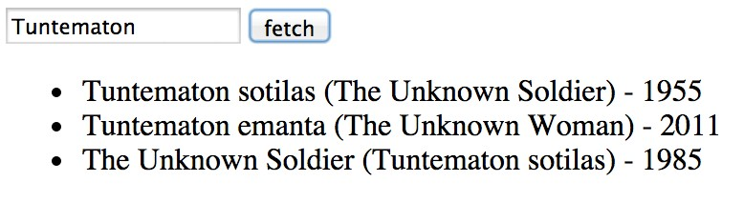
Using $resource on GET
// Load ngResource before this
var restApp = angular.module('restApp',['ngResource']);
restApp.controller("RestCtrl", function($scope, $resource) {
$scope.doClick = function() {
var title = $scope.movietitle;
var searchString = 'http://api.rottentomatoes.com/api/ public/v1.0/movies.json?apikey=key&q=' + title + '&page_limit=5';
var result = $resource(searchString);
var root = result.get(function() {
$scope.movies = root.movies;
});
// {method:'GET'
}
});

Slide 74
$resource methods
$resource contains convenient methods for
  get ('GET')
  save ('POST')
  query ('GET', isArray:true)
  remove ('DELETE')
Calling these will invoke $http (ajax call) with the speciﬁed http method (GET, POST, DELETE), destination and parameters

Slide 75






Passing Parameters
:title -­‐> parametrized URL template
// Load ngResource before this
var restApp = angular.module('restApp',['ngResource']);
restApp.controller("RestCtrl", function($scope, $resource) {
$scope.doClick = function() {
var searchString = 'http://api.rottentomatoes.com/api/public/ v1.0/movies.json?apikey=key&q=:title&page_limit=5';
var result = $resource(searchString);
var root = result.get({title: $scope.movietitle}, function() {
$scope.movies = root.movies;
});
}
Giving the parameter from
$scope
});

Slide 76






Using Services
Controller responsible for binding
// Load ngResource before this
var restApp = angular.module('restApp',['ngResource']);
restApp.controller("RestCtrl", function($scope, MovieService) {
$scope.doClick = function() {
var root = MovieService.resource.get({title: $scope.movietitle},
function() {
$scope.movies = root.movies;
});
}
});
Service responsible for the resource
restApp.factory('MovieService', function($resource) { factory = {};
factory.resource = $resource('http://api.rottentomatoes...&q=:title&page_limit=5');
return factory;
});

Slide 77





Simple Version
Just call get from MovieService
// Load ngResource before this
var restApp = angular.module('restApp',['ngResource']);
restApp.controller("RestCtrl", function($scope,
$scope.doClick = function() {
var root = MovieService.get({title:
function() {
$scope.movies = root.movies;
MovieService) {
$scope.movietitle},
});
}
Returns the resource
});
restApp.factory('MovieService', function($resource) {
return $resource('http://api.rottentomatoes...&q=:title&page_limit=5');;
});

Slide 78
ANIMATIONS AND UNIT TESTING

Slide 79
AngularJS Animations
Include ngAnimate module as dependency
Hook animations for common directives such as ngRepeat, ngSwitch, ngView
Based on CSS classes
– If HTML element has class, you can animate it
AngularJS adds special classes to your html-­‐ elements

Slide 80
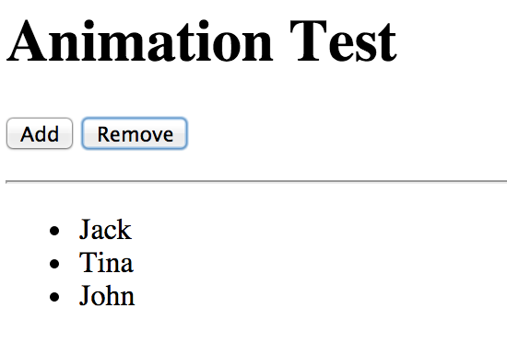



Example Form
<body ng-controller="AnimateCtrl">
<button ng-click="add()">Add</button>
<button ng-click="remove()">Remove</button></p>
<ul>
<li ng-repeat="customer in customers">{{customer.name}}</li>
</ul>
</body>
Adds and Removes names

Slide 81
Animation Classes
When adding a new name to the model, ng-­‐ repeat knows the item that is either added or deleted
CSS classes are added at runtime to the repeated element (<li>)
When adding new element:
  <li class="... ng-enter ng-enter-active">New Name</li>
When removing element
  <li class="... ng-leave ng-leave-active">New Name</li>

Slide 82
Directives and CSS
Event | Starting CSS | Ending CSS | Directives
enter | .ng-­‐enter | .ng-­‐enter-­‐active | ngRepeat, ngInclude, ngIf, ngView
leave | .ng-­‐leave | .ng-­‐leave-­‐active | ngRepeat, ngInclude, ngIf, ngView
move | .ng-­‐move | .ng-­‐move.active | ngRepeat

Slide 83
Example CSS
/* starting animation */
.ng-enter {
-webkit-transition: 1s; transition: 1s;
margin-left: 100%;
}
/* ending animation */
.ng-enter-active {
margin-left: 0;
}
/* starting animation */
.ng-leave {
-webkit-transition: 1s; transition: 1s;
margin-left: 0;
}
/* ending animation */
.ng-leave-active {
margin-left: 100%;
}

Slide 84
Test Driven Design
Write tests ﬁrsts, then your code
AngularJS emphasizes modularity, so it can be easy to test your code
Code can be tested using several unit testing frameworks, like QUnit, Jasmine, Mocha ...

Slide 85
QUnit
Download qunit.js and qunit.css
Write a simple HTML page to run the tests
Write the tests

Slide 86
<!DOCTYPE html>
<html>
<head>
<meta charset="utf-8">
<title>QUnit Example</title>
<link rel="stylesheet" href="qunit-1.10.0.css">
<script src="qunit-1.10.0.js"></script>
</head>
<body>
<div id="qunit"></div>
<script type="text/javascript">
function calculate(a, b) {
return a + b;
}
test(
ok( calculate(5,5) === 10,
ok( calculate(5,0) === 5, ok( calculate(-5,5) === 0,
});
"calculate test", function() {
);
);
);
"Ok!"
"Ok!"
"OK!"
</script>
</body>
</html>

Slide 87
Three Assertions
Basic
  ok( boolean [, message]);
If actual == expected
  equal( actual, expected [, message]);
if actual === expected
  deepEqual( actual, expected [, message));
Other
  http://qunitjs.com/cookbook/#automating- unit-testing

Slide 88
Testing AngularJS Service
var myApp = angular.module('myApp', []);
// One service myApp.service('MyService', function() {
this.add =
return
};
function(a, b) { a + b;
});
/* TESTS */
var injector = angular.injector(['ng', 'myApp']);
QUnit.test('MyService', function() {
var MyService = injector.get('MyService'); ok(2 == MyService.add(1, 1));
});

Slide 89
WRAPPING UP

Slide 90
Wrapping UP
AngularJS is a modular JavaScript SPA framework
Lot of great features, but learning curve can be hard
Great for CRUD (create, read, update, delete) apps, but not suitable for every type of apps
Works very well with some JS libraries (JQuery)

