Slide 1

<HTML5>
NEW AND IMPROVED
Adapted from Timothy Fisher

Slide 2
Less Header Code
More Semantic HTML tags Media Tags
Geolocation Canvas Input Types
Form Validation Local Storage WebSQL Storage Offline Applications Draggable
Cross-Domain Messaging Web Sockets
Web Workers History API
HTML5 Support Progressive Enhancement

Slide 3

HTML5 History
•
•
•
•
•
•
Specification of HTML published by W3C W3C HTML5 Spec => 900+ pages Work started on HTML5 in late 2003
First Working Draft published January 2008 Expected Candidate Recommendation - 2012 W3C Recommendation - 2022 or later *
* Requires 2 100% complete and fully interoperable implementations
http://dev.w3.org/html5/spec/

Slide 4
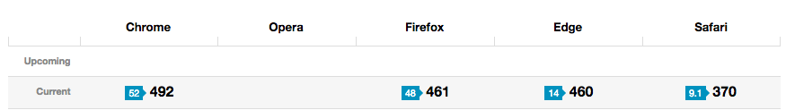


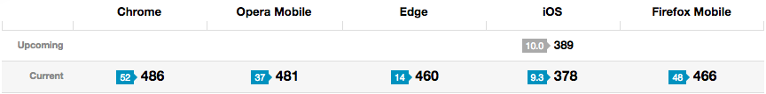
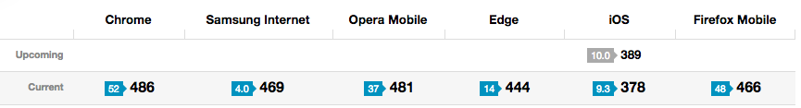
HTML5 Compatibilty (out of 555 pt)
http://www.HTML5test.com/
Desktop
Tablet
Smartphones

Slide 5
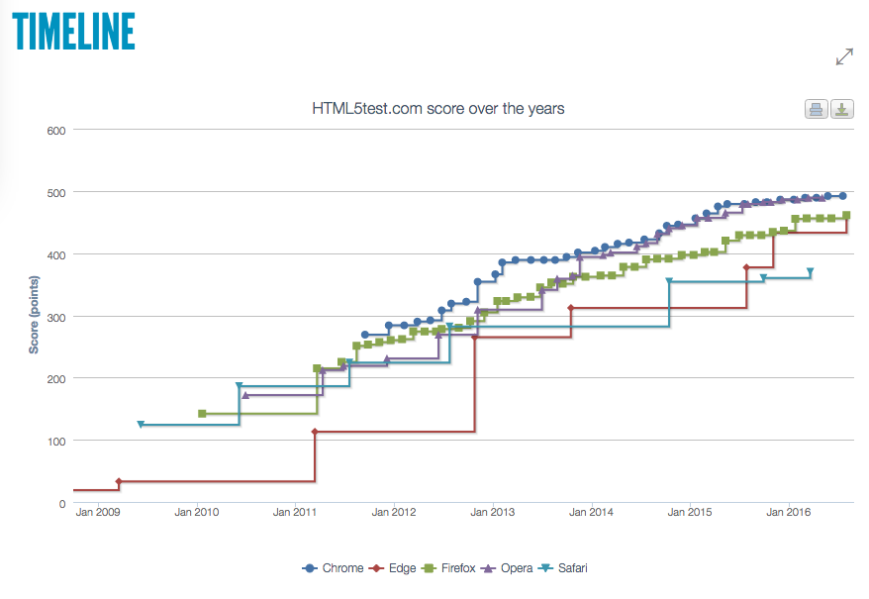
HTML5 Compatibilty

Slide 6
Less Header Code
Pre HTML5:
<!DOCTYPE HTML PUBLIC "-//W3C//Dtd HTML 4.01 Transitional//EN" "http:// www.w3.org/tr/html4/loose.dtd">
<html>
<head>
<meta http-equiv="Content-Type" content="text/html; charset=utf-8">
<title>Awesome Stuff</title>
</head>
...
With HTML5:
<!DOCTYPE HTML>
<html>
<head>
<meta charset=”utf-8”>
<title>Awesome Stuff</title>
</head>
...

Slide 7
No Need for Type Attribute
Pre HTML5:
<script type=”text/javascript” src=”script.js”> </script>
<link type=”text/css” href=”style.css”></link>
With HTML5:
<script src=”script.js”> </script>
<link href=”style.css”></link>

Slide 8




More Semantic HTML Tags
<div id=”header”>
<div id=”nav”>
<div id=”sidebar”>
<div id=”article”>
<div id=”footer”>

Slide 9

More Semantic HTML Tags
<header>
<nav>
<section>
<article>
<aside>
<footer>

Slide 10

More Semantic HTML Tags
Output
<output name="result"></output>
Progress
<progress id="p" max=100><span>0</span>%</progress>

Slide 11
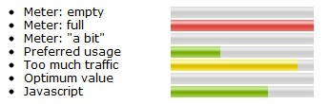
More Semantic HTML Tags
Meter
Storage space usage:
<meter value=6 max=8>6 blocks used (out of 8 total)</meter>
Voter turnout:
<meter value=0.75><img alt="75%" src="graph75.png"></meter>
Tickets sold:
<meter min="0" max="100" value="75"></meter>

Slide 12
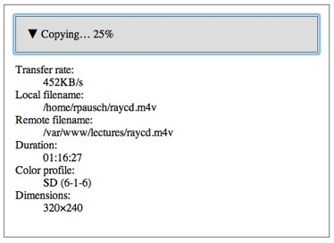
More Semantic HTML Tags
Details and Summary
<details>
<summary>
American League Central Division
</summary> Detroit Tigers<br/>
Minnesota Twins<br/> Chicago White Sox<br/> Cleveland Indians<br/> Kansas City Royals<br/>
</details>
Use to create an expanding and contracting element that you can use to hide details without JavaScript

Slide 13
More Semantic HTML Tags
Address
<address>
Written by:<br/>
<a href="/people/show/23">Timothy Fisher</a>, <br/> Address: 25296 Hunter Lane, Flat Rock, MI 48134 <br/> Phone: 555-1212
</address>
Address applies to the nearest Article or Body tag.
Prior to HTML5 the Address element applied to the document/body as a whole

Slide 14
More Semantic HTML Tags
Data Attributes
<div class="car" data-brand="ford" data-model="mustang">
<button class="fire">
</div>
//Using DOM's getAttribute() property
var brand=mydiv.getAttribute("data-brand") //returns "ford" mydiv.setAttribute("data-brand", "mazda") //changes "data-brand" to "mazda" mydiv.removeAttribute("data-brand") //removes "data-brand" attribute entirely
//Using JavaScript's dataset property
var brand=mydiv.dataset.brand //returns "ford" mydiv.dataset.brand='mazda' //changes "data-brand" to "mazda" mydiv.dataset.brand=null //removes "data-brand" attribute
Custom data attribs were always possible but prior to HTML5 they would cause validation errors.

Slide 15
More Semantic HTML Tags
Section, hgroup, Article
<article>
<hgroup>
<h1>Mobile Phones</h1>
<h2>Different Smart Phones</h2>
</hgroup>
<p>Some of the more popular mobile smart phones</p>
<section>
<h1>Apple iPhone</h1>
<p>A popular smart phone from Apple.</p>
</section>
<section>
<h1>Android-based Phones</h1>
<p>A series of smart phones that use the Google Android operating system.</p>
</section>
</article>
These elements replace many of your divs

Slide 16

More Semantic HTML Tags
Figure and Figure Caption
<figure>
<img src="ninja_guy.jpg" alt="A Standing Ninja Guy.">
<figcaption>Cool Ninja Guy</figcaption>
</figure>
Cool Ninja Guy
The browser can position the caption for you

Slide 17
More Semantic HTML Tags
Menu and Command
<menu label="Hero List">
<command type="radio" radiogroup="herolist" label="Spiderman">
<command type="radio" radiogroup="herolist" label="Superman">
<command type="radio" radiogroup="herolist" label="Batman">
</menu>
a simple radio button group

Slide 18
More Semantic HTML Tags
Menu (continued)
<menu type="toolbar">
<li>
<menu label="File">
<button type="button" onclick="file_new()">New...</button>
<button type="button" onclick="file_open()">Open...</button>
<button type="button" onclick="file_save()">Save...</button>
<button type="button"onclick="file_saveas()">Save As...</button>
</menu>
</li>
<li>
<menu label="Edit">
<button type="button" onclick="edit_copy()">Copy...</button>
<button type="button" onclick="edit_cut()">Cut...</button>
<button type="button" onclick="edit_paste()">Paste...</button>
</menu>
</li>
</menu>

Slide 19
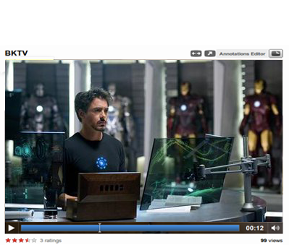
Media Tags
<video src=” ironman.ogg” />
Automatically show native controls
<video src=”ironman.ogg” controls />
http://www.youtube.com/html5

Slide 20







Media Tags
<video controls/>
<source src=”ironman.mp4” />
<source src=”ironman.ogg” />
</video>
ironman.mp4 ironman.ogg
Specify multiple source elements to support more browsers
(i.e. mp4 willl work in Safari, ogg will work in Firefox)

Slide 21

Media Tags
<audio src=” teenage_dream.mp3”></audio>
<audio controls>
<source src=”teenage_dream.mp3”/>
<source src=”teenage_dream.ogg”/>
</audio>
Provides a download link for non-supporting browsers:
<audio src=”teenage_dream.ogg” autoplay controls loop>
<a href=” teenage_dream.ogg”>download</a>
</audio>

Slide 22

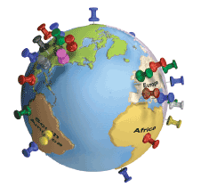
Native GeoLocation
Build location-aware apps without access to native mobile apis
navigator.geolocation.getCurrentPosition( function(position) {
// display position
}
);

Slide 23
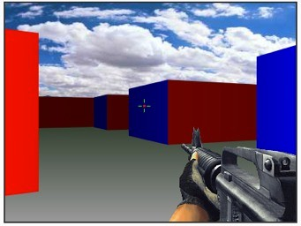
Canvas
A complete drawing and animation API
<canvas id=”square”> fallback content
</canvas>
<script>
// create basic filled square
canvas = canvas.getElementById(ʻsquareʼ); context = canvas.getContext(ʻ2dʼ); context.fillStyle = “#000000”;
context.fillRect(0, 0, 100, 100);
</script>
http://www.theopensourcery.com/keepopen/2010/html5-canvas-demo/ http://www.benjoffe.com/code/demos/canvascape/

Slide 24
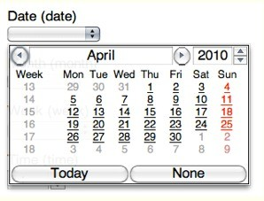
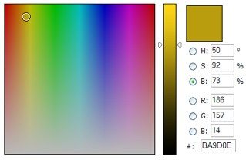
Input Types
<input type=”email” />
tel search email url
datetime date range color
Unsupported browsers default to text type Future browsers will display appropriate UI controls

Slide 25

Input Types
Input Type Range + Datalist
<input type="range" min="-100" max="100" value="0" step="10" name="power" list="powers">
<datalist id="powers">
<option value="0">
<option value="-30">
<option value="30">
<option value="+50">
</datalist>

Slide 26
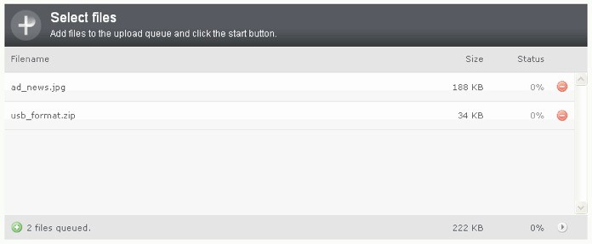
Input Types
File Upload Multiple
<input type=file multiple>

Slide 27

Input Types
Datalist
<input list="movies" />
<datalist id="movies">
<option>The Dark Knight</option>
<option>Spiderman 3</option>
<option>X-Men</option>
</datalist>
Used to provide Auto Complete feature

Slide 28
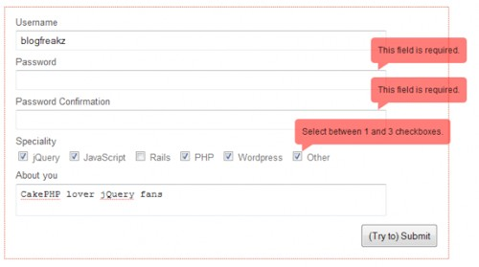
Form Validation
<input name="custname" required>
<script>
form.checkValidity();
</script>
By adding ‘required’ attribute you can take advantage of validity checking without custom JavaScript.

Slide 29
Form Validation
Custom Validation
<label>Gender: </label>
<input name=”gender” type="text" oninput="check(this)">
<script>
function check(input) {
if (input.value != "male" && input.value != "female") { input.setCustomValidity('"' + input.value + '" is not a gender.');
}
else {
// input is good - reset error message
input.setCustomValidity('');
}
}
</script>

Slide 30

Local / Session Storage
sessionStorage.setItem(key, value); sessionStorage.getItem(key);
localStorage.setItem(key, value); localStorage.getItem(key);
Save key/value pairs to a client-side data store implemented by browser Session store expires when the browser is closed

Slide 31

WebSQL Storage
A set of APIs to manipulate client-side databases using SQL
// open/create a database
var db = openDatabase(db_name, version, db_desc, est_size);
// create a table and insert some data
db.transaction(function (tx) {
tx.executeSql('CREATE TABLE foo (id unique, text)'); tx.executeSql('INSERT INTO foo (id, text) VALUES (1, "synergies")');
});
// select data and display it
tx.executeSql('SELECT * FROM foo', [], function (tx, results) { var len = results.rows.length, i;
for (i = 0; i < len; i++) { alert(results.rows.item(i).text);
}
});

Slide 32



Offline Applications
Offline Applications using manifest
<html manifest=”cache.manifest”>
provide a cache.manifest file:
CACHE MANIFEST
clock.html clock.css clock.js
uses MIME type:
text/cache-manifest
Run a web application in offline mode, disconnected from Internet
Of course your app will still have failures if it tries to pull live data from the Internet

Slide 33

Offline Applications
Detect Online or Offline
window.addEventListener("online", function() { do_something();
}, true);
window.addEventListener("offline", function() { do_something();
}, true);

Slide 34
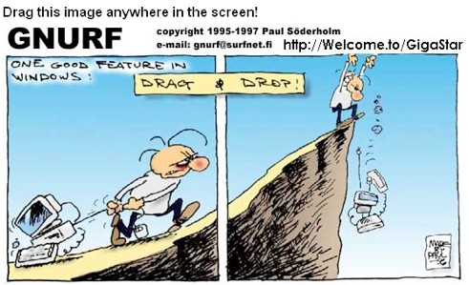
Draggable
<div draggable=”true”></div>
// set data to access at target
addEvent(div, “dragstart”, function(e) { e.dataTransfer.setData(ʻfooʼ, ʻbarʼ);
}, true);
// access data from dragged object
addEvent(div, ʻdragendʼ, function(e) { e.dataTransfer.getData(ʻfooʼ);
}, true);
HTML5 drag and drop should work across frames, and across browser windows.
HTML5 drag and drop also allows users to drag and drop data to and from non-web applications, i.e. out of the browser or into the browser

Slide 35
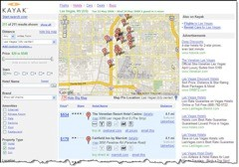
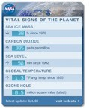


Cross-Domain Messaging
// sender
var o = document.getElementsByTagName('iframe')[0]; o.contentWindow.postMessage('Hello world', 'http://b.example.org/');
// recipient
addEvent(window, "message", function(e){ document.getElementById("rcvd_message").innerHTML = e.origin + " said: " + e.data;
});

Slide 36

Editable Content
Turn any element into an editable area
<script>
document.getElementById(ʻnotepadʼ).contentEditable = true;
</script>

Slide 37

Web Sockets
Opens a persistent connection to the server
Can be used for server to browser push
Restricted communication to origin server
Eliminates need to poll for data
var ws = new WebSocket("ws://friendfeed.com/websocket"); ws.onopen = function() {
ws.send("This is a message from the browser to the server");
};
ws.onmessage = function(event) {
alert("The server sent a message: " + event.data);
};

Slide 38

Web Workers
Provide “threads” for JavaScript execution
Donʼt have access to DOM or page.
Have to communicate through postMessage API

Slide 39
Web Workers
In the Browser
// Create a Web Worker
var worker = new Worker(“worker.js”);
// Post a message to the Web Worker
worker.postMessage(0);
// Triggered by postMessage in the Web Worker
worker.onmessage = function(evt) {
// evt.data is the values from the Web Worker
alert(evt.data);
};
// Catch Web Worker error
worker.onerror = function(evt) { alert(evt.data);
};

Slide 40
Web Workers
In the Web Worker
// Triggered by postMessage in the page
onmessage = function(evt) {
// evt.data will be 0 here
for (var i=evt.data, k=1000001; i<k; i++) {
// Continually sends data back
postMessage(i);
};
};

Slide 41
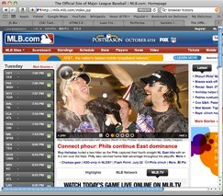
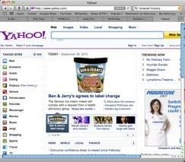
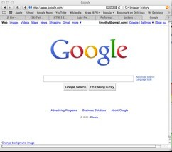


History API
JavaScript API for moving through browser history
window.history.back(); window.history.forward();
window.history.go(2); window.history.length;
window.history.pushState(data, title, url); window.history.replaceState(data, title, url);

Slide 42
HTML5 Compatibilty
HTML5Test.com scores browsers according to the following criteria:
•
•
•
•
•
•
•
•
Parsing Rules
•
•
•
•
•
•
•
•
Microdata
Canvas
Web Applications
Video
Geo Location
Audio
WebGL
Local Devices
Communication
Elements
Files
Forms
Storage
User Interaction
Workers

Slide 43
Progressive Enhancement
•
•
•
Use HTML5 when available
Fallback to a different mechanism when not available Supported by many libraries including jQuery.
if HTML5 video is not supported, flash video will load
<video controls width="500">
<source src="video.ogg" />
<source src="video.mp4" />
<embed src="http://blip.tv/play/gcMV" type="application/x-shockwave-flash" width="1024" height="798" allowscriptaccess="always" allowfullscreen="true"></embed>
</video>

Slide 44
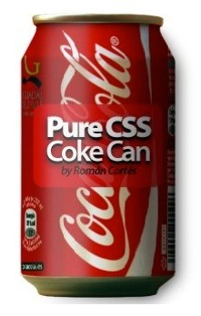
DON’T FORGET CSS3
Rounded corners
Box shadows
Transitions
Rotate
Gradients
Text shadow
Web fonts
http://www.webhostingsearch.com/20-of-the-best-examples-of-css

Slide 45
Recommended Sites
http://html5.timothyfisher.com
http://www.HTML5test.com http://html5demos.com http://caniuse.com
This Presentation:
http://www.slideshare.net/timothyf/html5-new-and-improved

