Slide 1
MOOCS
thanks to
Paul Olivier Dehaye

Slide 2
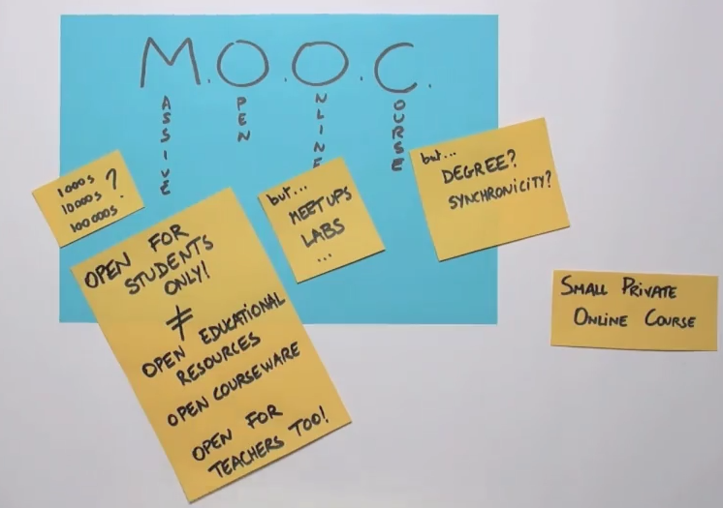

Slide 3
Some numbers
MIT MOOC (MITx - 6.002x: Circuits and Electronics.),
154,763 registrants.
69,221 people (45% ) looked at the first problem set,
26,349 earned at least one point (17%)
Midterm assignment
13,569 people looked at it while it was still open
9,318 people got a passing score on the midterm (6%)
7,157 people earned the first certificate (4,6% of the enrolled, i.e. 27% of those who really manifested interest).

Slide 4
Some numbers
Coursera’s Social Network Analysis class
61,285 students registered,
1303 (2%) earned a certificate,
107 earned "the programming (i.e. with distinction) version of the certificate” (0.17%).

Slide 5
Questions
Where do the students come from?
Which videos are most popular, and which ones attract little interest?
Are students actually watching the videos on the assigned dates?
Are viewers watching all the way through?
At what point in the lecture, if any, do viewers stop watching?
Are there any portions of the videos that are being watched repeatedly?
Are the students watching the videos by the assigned deadlines?
Do the videos generating active user engagement? Do students edit, share, download the material?

Slide 6
History of Mooc
origins and evolution
x-moocs vs c-moocs
https://class.coursera.org/massiveteaching-001/lecture/15
why now?
https://class.coursera.org/massiveteaching-001/lecture/25

Slide 7
George Siemens and c-moocs
George Siemens https://youtu.be/mfr7d6zYMus 3:46
George Siemens https://youtu.be/yx5VHpaW8sQ

Slide 8
x-moocs
Anant Agrawal https://youtu.be/rYwTA5RA9eU 15 min
Daphne Koller https://youtu.be/U6FvJ6jMGHU
20 min
Peter Norwik https://youtu.be/tYclUdcsdeo 6 min

Slide 9
The model
Analytics
https://class.coursera.org/massiveteaching-001/lecture/21
Startup iteration cycle
https://class.coursera.org/massiveteaching-001/lecture/23

Slide 10
What is important in teaching?
Focus as a teacher
https://class.coursera.org/massiveteaching-001/lecture/7
How moocs can be helpful?
feedback
https://class.coursera.org/massiveteaching-001/lecture/17

